Slide 1

Module 5
Model Building
Notes:
Guidelines
Use section headers to chunk content in your presentation.
Use the same style of section header throughout your presentation.
Keep your title to no more than 2 lines.

Slide 2
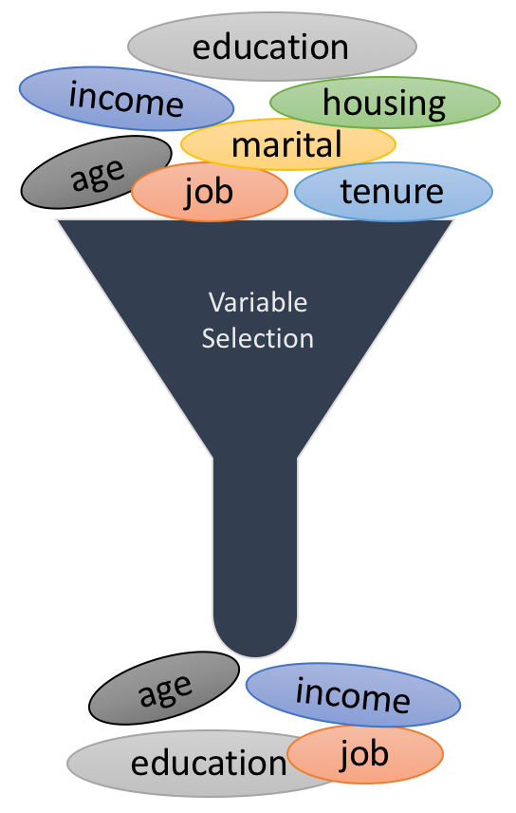
Variable Selection
Notes:
Guidelines
Use a title slide at the beginning of your presentation. There are 9 variations of title slides to choose from.
If you will have a series of slideshows, we recommend using the same style of title slide for each presentation.
Keep your title to no more than 2 lines.
Do not change the font style or font size of the title or subtitle.

Slide 3
Performance Metrics for Model Selection
We want a descriptive model with
A high R²
A high Adjusted R²
Low RMSE
Short Prediction Interval
Significant p-values
For Predictive Models
A high R²
Low MSE in the test data set (validation)
Low RMSE in the test data set (validation)
Low AIC (Akaike Information Criterion) in test data set
Low BIC (Bayesian Information Criterion) in test data set

Slide 4
Performance Metrics to Select Variables
Besides the metrics to select the best models. We can use:
AIC (Akaike Information Criterion)
BIC (Bayesian Information Criterion)
C_{p} Statistic

Slide 5
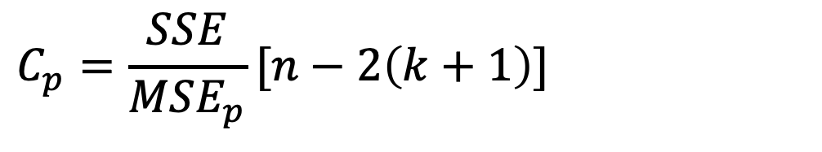
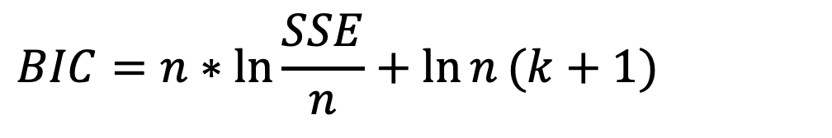
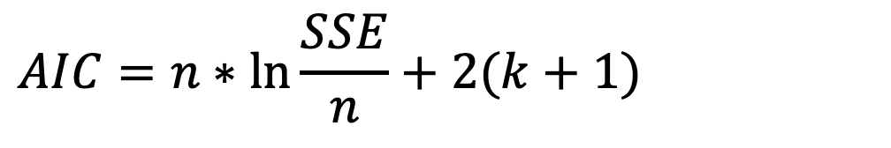
Performance Metrics to Select Variables
AIC (Akaike Information Criterion):
BIC (Bayesian Information Criterion):
C_{p} Statistic
$$AIC=n∗\ln{\frac{SSE}{n}}+2(k+1)$$
$$BIC=n∗\ln{\frac{SSE}{n}}+\ln{n}(k+1)$$
$$C_{p}=\frac{SSE}{MSE_{p}}[n−2\left(k+1\right)]$$

Slide 6
All-Subsets Regression
Notes:
Guidelines
Use a title slide at the beginning of your presentation. There are 9 variations of title slides to choose from.
If you will have a series of slideshows, we recommend using the same style of title slide for each presentation.
Keep your title to no more than 2 lines.
Do not change the font style or font size of the title or subtitle.

Slide 7
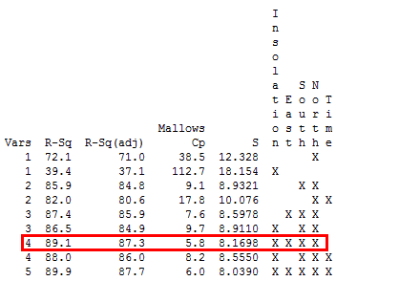
All-Subsets Regression
Tests all possible subsets of the set of potential variables.
Includes all possible combinations

Slide 8
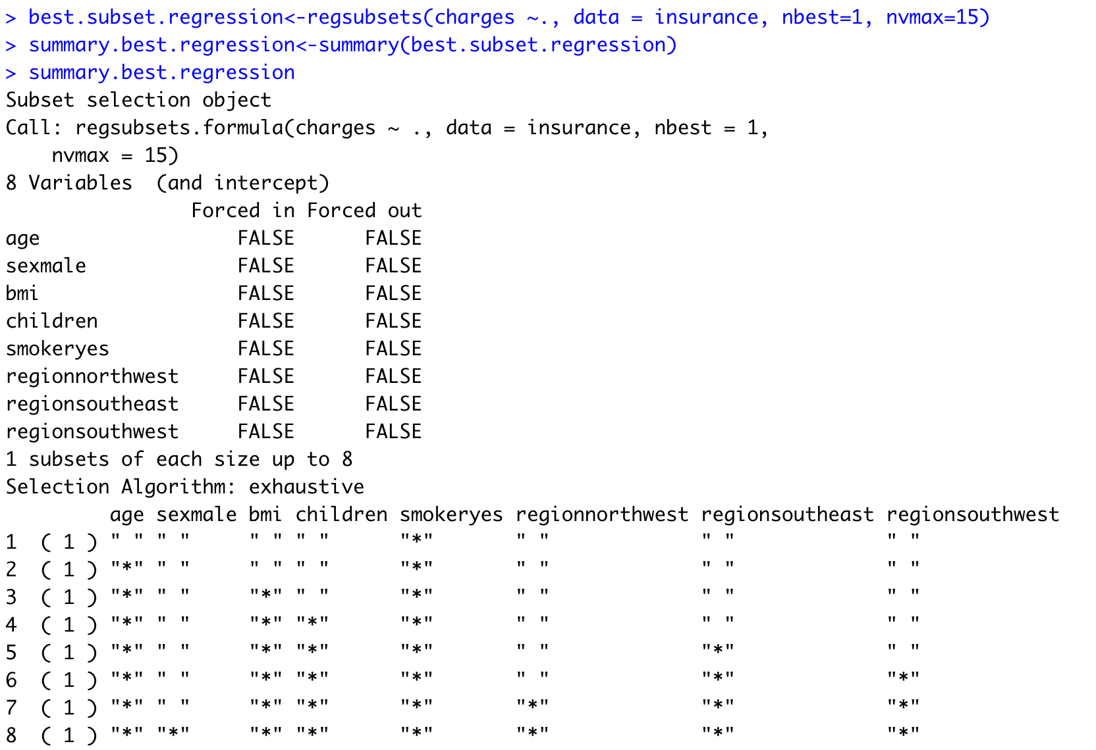
All-Subsets Regression
Tests all possible subsets of the set of potential variables.

Slide 9
All-Subsets Regression

Slide 10
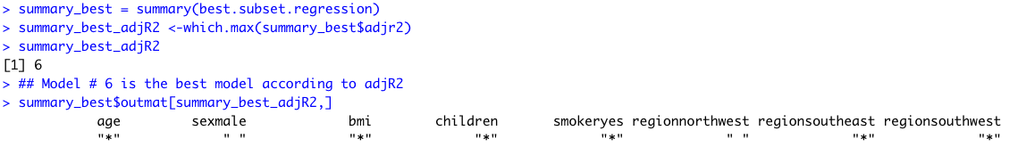
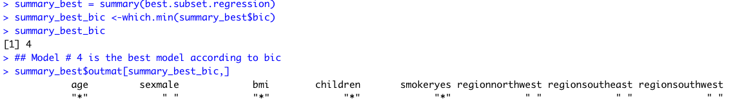
All-Subsets Regression
You can rank-order Best Models According to:
Example Based on Adj-R2:
Example Based on BIC:

Slide 11

Practice

Slide 12
Backward Variable Selection
Notes:
Guidelines
Use a title slide at the beginning of your presentation. There are 9 variations of title slides to choose from.
If you will have a series of slideshows, we recommend using the same style of title slide for each presentation.
Keep your title to no more than 2 lines.
Do not change the font style or font size of the title or subtitle.

Slide 13
All-Subsets Regression
Tests all possible subsets of the set of potential variables.
Includes all possible combinations
Example: 20 variables
All subsets will need:
The subset with no variables (the intercept-only model),
All individual variables,
All possible combinations of 2, 3, 4, …,20 variables.
In other words, 2²⁰ = 1,048,576 regression models

Slide 14
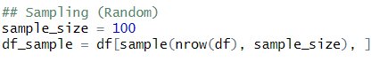
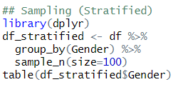
High # of Observations
In a statistical study, sampling is used to select observations from a dataset to be in the study.
Sampling can be done randomly, e.g.,:
We can also do stratified sampling, e.g.,:

Slide 15
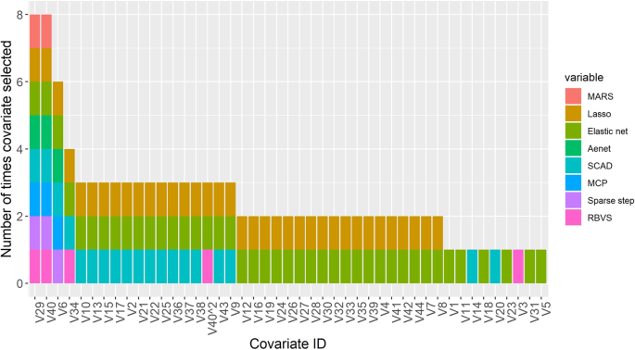
High # of Variables
We need more efficient variable screening algorithms

Slide 16
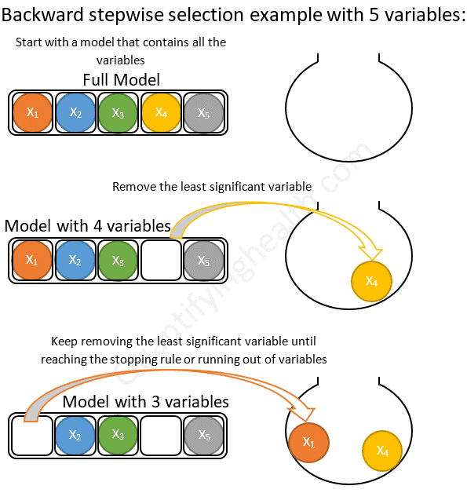
Backward Variable Screning
LARGEST MODEL
SMALLEST MODEL
full=lm(y ~ .,data=data)
null=lm(y ~ 1,data=data)

Slide 17
Backward Variable Screening in R
Create the smallest model you want to consider, e.g.,
null=lm(y ~ 1,data=data)
Create the largest model to consider, e.g.,
full=lm(y ~ .,data=data)
Create backward regression object with the following:
step(full, scope=list(lower=null,upper=full),direction= “backward”, trace=2, k=2)
scope determines lower and upper bound of models
direction determines type of variable selection model: “backward”
trace will determine the output. Larger value shows more output
k = 2 will use AIC as selection criterion. k = log(n) uses BIC

Slide 18
Practice

Slide 19
Forward Variable Selection
Notes:
Guidelines
Use a title slide at the beginning of your presentation. There are 9 variations of title slides to choose from.
If you will have a series of slideshows, we recommend using the same style of title slide for each presentation.
Keep your title to no more than 2 lines.
Do not change the font style or font size of the title or subtitle.

Slide 20
Forward Variable Screening
LARGEST MODEL
SMALLEST MODEL
full=lm(y ~ .,data=data)
null=lm(y ~ 1,data=data)

Slide 21
Forward Variable Screening in R
Create the smallest model you want to consider, e.g.,
null=lm(y ~ 1,data=data)
Create the largest model to consider, e.g.,
full=lm(y ~ .,data=data)
Create forward regression object with the following:
step(null, scope=list(lower=null,upper=full),direction= “forward”, trace=2, k=2)
scope determines lower and upper bound of models
direction determines type of variable selection model: “forward”
trace will determine the output. Larger value shows more output
k = 2 will use AIC as selection criterion. k = log(n) uses BIC

Slide 22
Practice

Slide 23
Stepwise Variable Selection
Notes:
Guidelines
Use a title slide at the beginning of your presentation. There are 9 variations of title slides to choose from.
If you will have a series of slideshows, we recommend using the same style of title slide for each presentation.
Keep your title to no more than 2 lines.
Do not change the font style or font size of the title or subtitle.

Slide 24
Stepwise Variable Screening
LARGEST MODEL
SMALLEST MODEL
full=lm(y ~ .,data=data)
null=lm(y ~ 1,data=data)
Variables Can Also be Dropped

Slide 25
Stepwise Variable Screening in R
Create the smallest model you want to consider, e.g.,
null=lm(y ~ 1,data=data)
Create the largest model to consider, e.g.,
full=lm(y ~ .,data=data)
Create stepwise regression object with the following:
step(null, scope=list(lower=null,upper=full),direction= “both”, trace=2, k=2)
scope determines lower and upper bound of models
direction determines type of variable selection model: “both”
trace will determine the output. Larger value shows more output
k = 2 will use AIC as selection criterion. k = log(n) uses BIC

Slide 26
Practice

